Slide 1
Benefits Claims Decision Support System Date: 1/19/16 PM: Elizabeth Wollin
Schedule | Staffing | Funding | Integration | Stakeholder Comms | VBA Overall | OI&T Overall
 | ● | ● | N/A | ● | ● | ●
Cross Dependencies: N/A
Completed this Week:
Review of Sandbox Data
Setting up Team on MS Project
Setting up Embarcadero Data Architect
Setting up Team on JIRA w/ GIT integration
Approvals for Team F2F working sessions week of 1/25
Monthly reports for PST for VA
Meetings on Data after SMEs reviewed
Initial Estimate on LOE to “good Usable Data”.
Overdue:
None
Due Next Week:
Work on Data, Database Analysis to determine “Good Usable Data”
Data, Final Estimate on LOE to “Good Usable Data”
Cleaned SDD document with draft content – prior to working sessions
Initial Schedule for week of 1/25
Meetings on DB design and storage
Working sessions
Outline of all impacts to schedule
Acquisition Package and CR Updates:
N/A

Slide 2
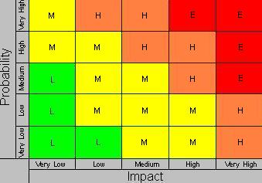
Benefits Claims Decision Support System Date: 12/11/15 PM: Elizabeth Wollin
Risk 1:
Title: Schedule [12/11/15]
Risk: If delays in obtaining data.
Impact: The deliverables will be delayed.
Mitigation Steps to Date:
Regularly communicate timeline and data needs with VA PM.
Action Items:
VA PM working to obtain required agreements for data and data transfer.
Who: VA PM Due Date: Ongoing
Risk 2:
Title: Technical [12/11/15]
Risk: If expectations re: Mitre Scripts and Analysis duplication.
Impact: VA Stakeholder buy-in may not be obtained.
Mitigation Steps to Date:
Clearly Communication project approach and potential benefits with Business and Technical subject matter experts (SMEs).
Action Items:
Coordinates project meetings with Business and Technical SMEs.
Who: VA PM and Project Team Due Date: Ongoing
1
2

